Slide 1
FLS Unit 5
Johnny Vogt

Slide 2
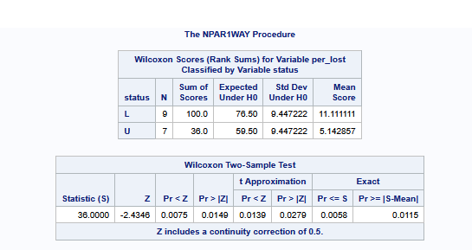
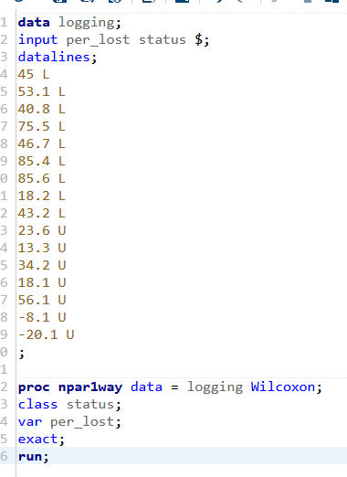
Question 2 SAS

Slide 3
Quick Questions!!!!
C.
2. C, again. The just because the pvalues fell on opposite side of .05, doesn’t mean the approximation is wrong. It just means that its really close to the significance value and that we are in danger of making either Type of error.

Slide 4
SAS Analysis
H0: Median of tree saplings in logged areas = Median of tree saplings unlogged areas
Ha: Median of tree saplings in logged areas != Median of tree saplings unlogged areas
There is sufficient evidence at the alpha level at .05 and a P-Value at .0058 to suggest that the amount of tree saplings in the unlogged areas are less than the logged counterparts.

Slide 5
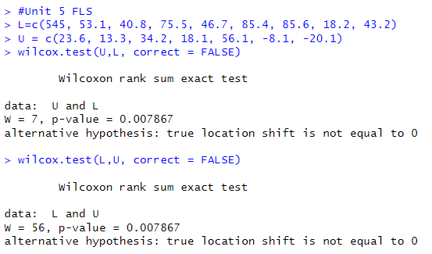
Question 2 R Test

Slide 6
Takeaways
Its defnitely interesting that SAS and R would have different Pvalues for the same test. I wonder what exactly causes that difference? Just randomness?
Why does the Wilcoxon test give us the Z Statistic instead of the t statistic, when we don't know the whole population?
Does adding in a continutity correction let us "assume" that the test covers the "True" Population (relates to the takeaway above)
I get mixed up on the fact that I'm thinking that we're looking for a lower number "less tree seedlings", but its actually the opposite because we're looking at the higher percentage of lost seedlings. It seems a bit backwards in my head.

